Slide 1
Welcome!
First Day by Adam Rosenblatt
Welcome. You are here to learn but it is also OK sometimes just to be, here. Welcome. We live in a time of extraordinary pain, complicated and specific pain, and I do not expect you simply to shed that when you arrive at this virtual door. What I do want you to shed is the notion that you can learn while trying to meet everyone's expectations: that you are here to perform for me, for anyone.
Welcome. At the quarry where I've been swimming this summer with my kids, who are stretching out a bit more every day, there are swallows. They fly in irregular circles, dipping down into the water, the source of all of us, and flying out again into their own unimaginable lives. They are welcome. They find the water somehow, I am not sure how.
You are welcome. Find the water somehow. I know you can.
We’ll start a 12am sharp. Slides / notes are posted after class.
While you wait:
There’s music playing
Introduce yourself to the people next to you
Check out the syllabus on Canvas

Slide 2
CS 141
WELCOME!
Today:
About the course
About me
About you
About experts and novices
Programming!
Syllabus notes

Slide 3
Covid precautions
Stay home if sick! You get 3 missed lectures; come talk to me if you need more. I have several very immunocompromised people in my circle I’m trying to protect.
Masks work! Please consider: This week it was estimated 1 in 40 have Covid right now : that means at least 2 people in this room!
Violet Blue’s pandemic roundup (she also does an excellent cybersecurity roundup) has science based updates each Thursday

Slide 4
Which class is this?
Who has read the course description?
What is this class about?
Why do we care?
What will you learn?
What will you not learn?

Slide 5
From the course catalog :
Basic concepts of computer programming using an object oriented programming language. Topics covered: introduction to the development environment, introduction to algorithms, elements of a programming language, including data types, packages, control structures, procedures and functions, basic input and output, arrays and records, text files, strings, variant records. Algorithm development, problem solving and software engineering are emphasized.

Slide 6
From the course catalog :
Basic concepts of computer programming using an object oriented programming language. Topics covered: introduction to the development environment, introduction to algorithms, elements of a programming language, including data types, packages, control structures, procedures and functions, basic input and output, arrays and records, text files, strings, variant records. Algorithm development, problem solving and software engineering are emphasized.
Q: what

Slide 7
My pledge to you : You will learn much more than syntax … you will learn …
How to think like a computer programmer
How to comment code correctly
How to debug your programs
How to write pseudocode
How to design, implement, and fine-tune a computer program
etc.

Slide 8
My pledge to you : You will learn much more than syntax … you will learn …
How to think like a computer programmer
How to comment code correctly
How to debug your programs
How to write pseudocode
How to design, implement, and fine-tune a computer program
etc.
What does “syntax” mean?

Slide 9
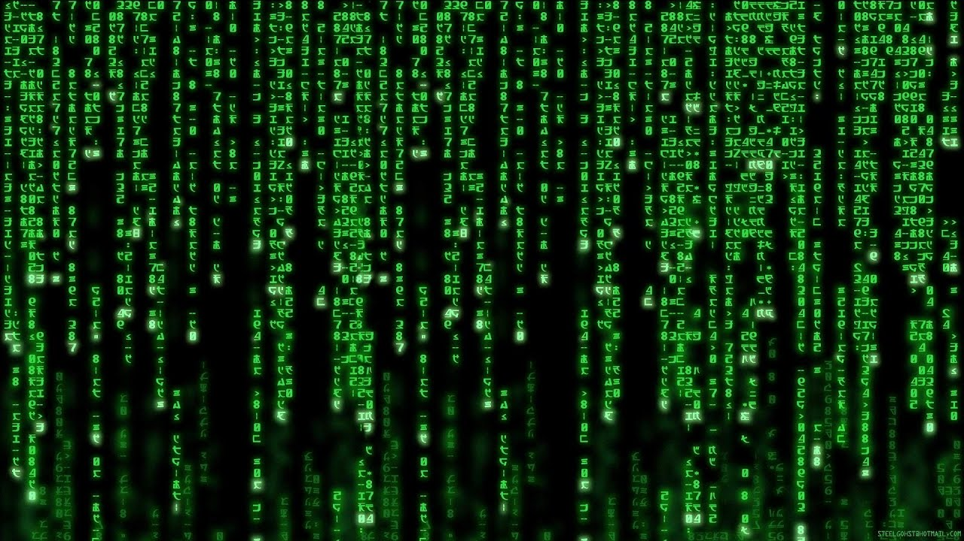
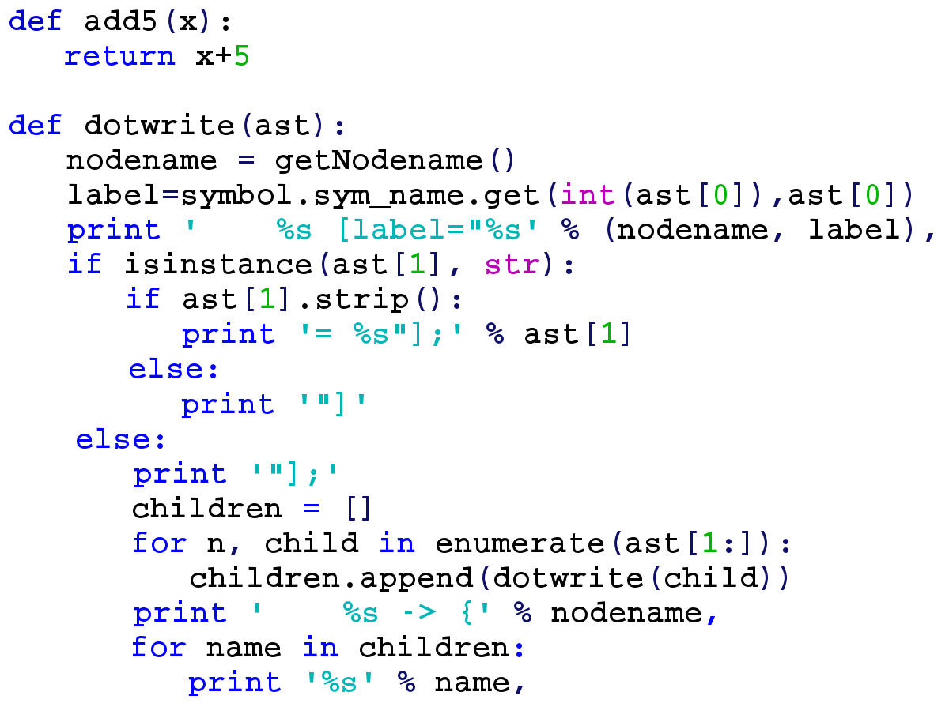
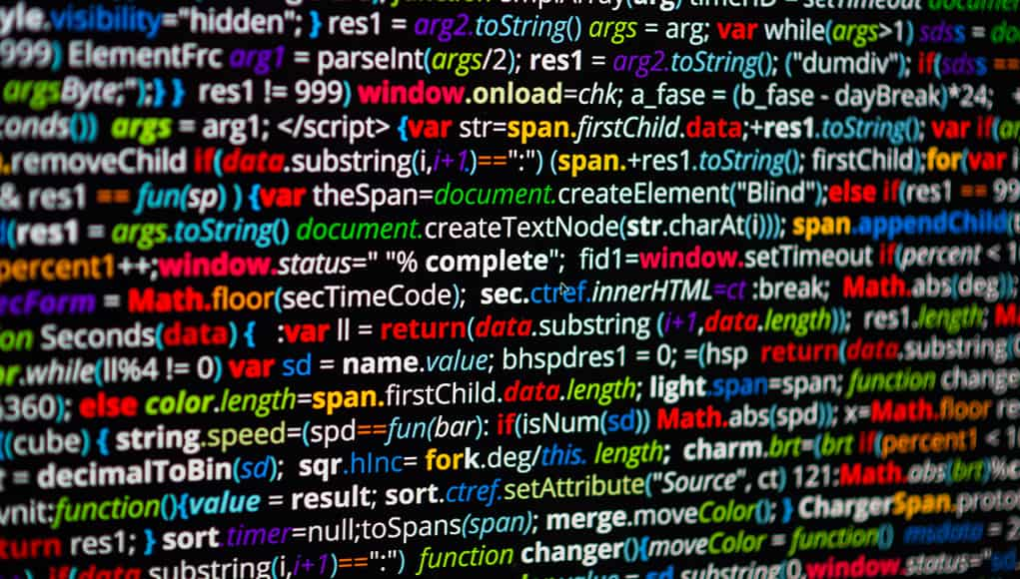
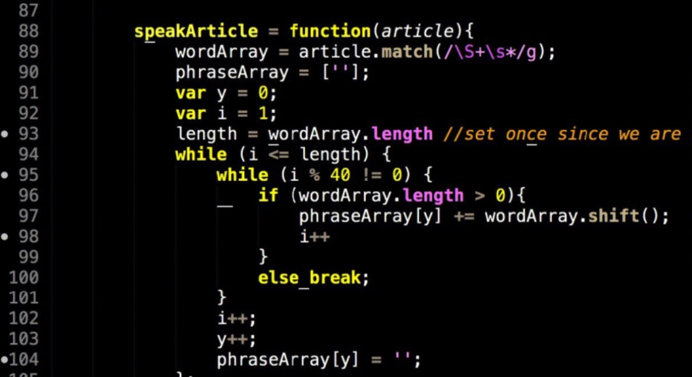
Syntax
Notes:
Hacker Typer exercise

Slide 10
Draw an OWL

Slide 11
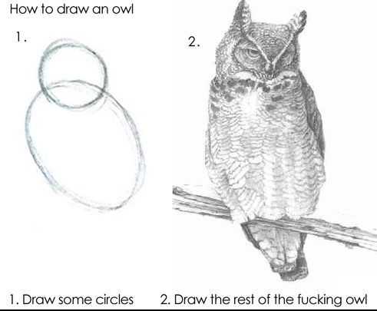

Draw an own

Slide 12
Draw an own

Slide 13
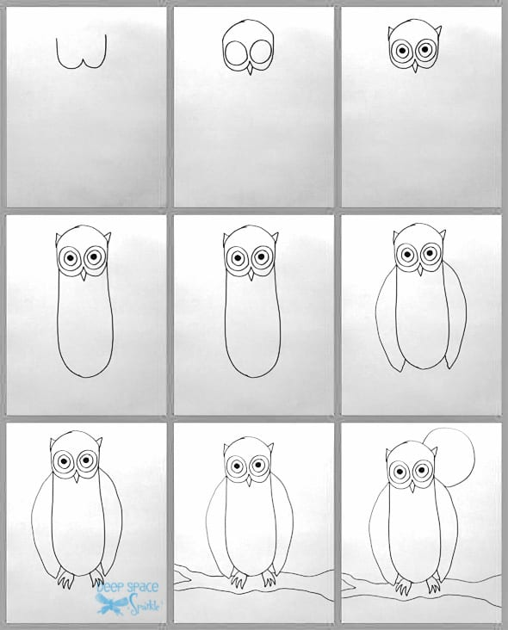
This class

Slide 14
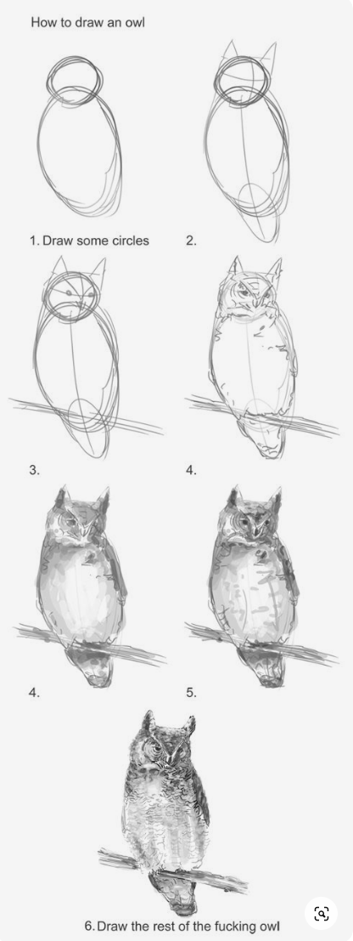
CS Degree

Slide 15
Process
“Computer Science [is] the study of process” – Alan Perlis
Notes:
Alan Perlis is literally one of the people who named the new field ‘Computer Science’
“Perhaps I may have been misunderstood as to the purpose of my proposed first course in programming. It is not to teach people how to program a specific computer, nor is it to teach some new languages. The purpose of a course in programming is to teach people how to construct and analyze process…..
Learning programming gives everyone access to the enormous power of being able to create models of their world and ask questions through simulations….” (1961)

Slide 16
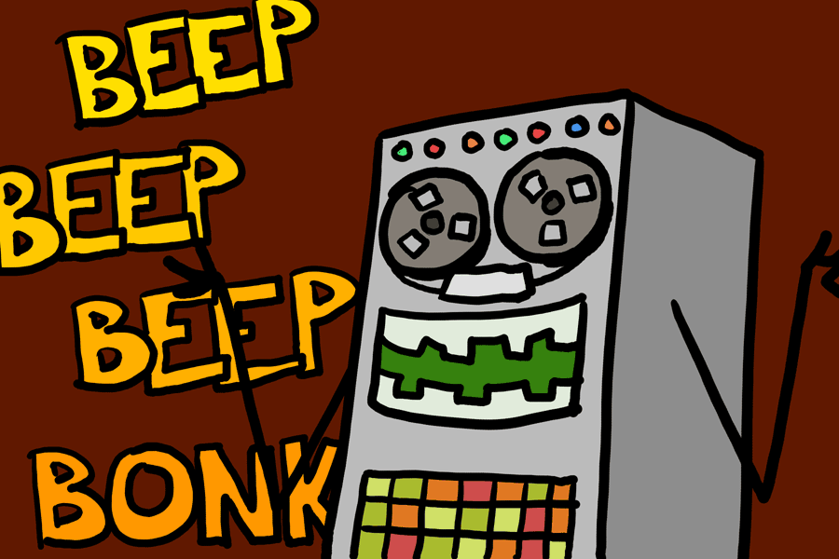
Why this art
Title: I computered it
Notes:
http://www.explodingdog.com/mayfourteen/iwritecomp.html

Slide 17

1st picture
Notes:
artist started drawing stick figures in 2000

Slide 18
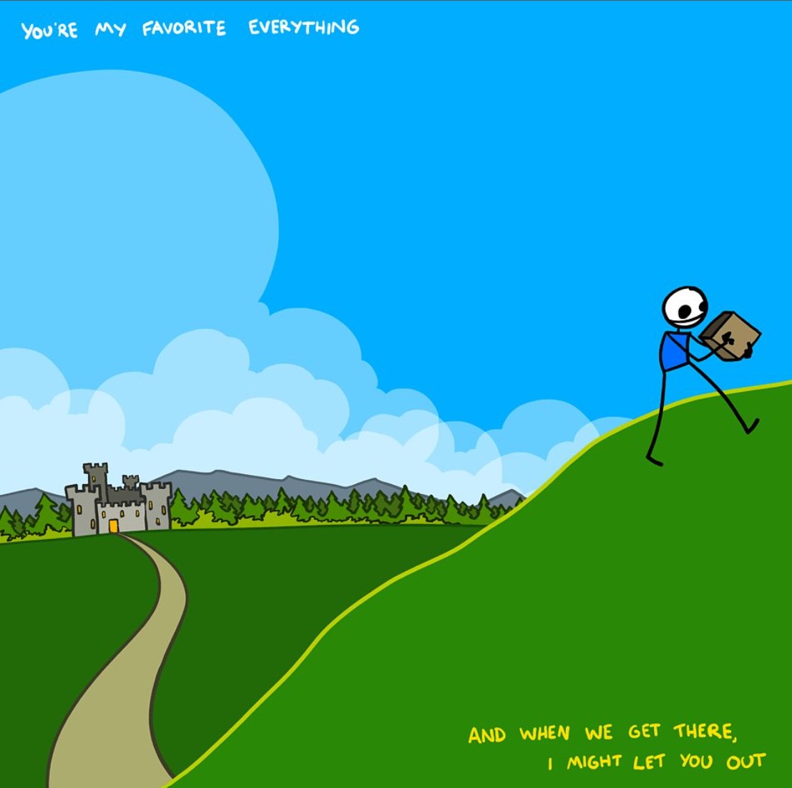

Notes:
A few years later was doing it professionally https://www.buildingaworld.com/collections/original-art
You might be starting out drawing stick figures, but do it every day and you’ll get amazing at it

Slide 19
Why I love programming
Notes:
Whatever effect you want to have in the world, CS can help you do it more powerfully.
You can do anything, if you can figure it out.
You can figure it out. There is an answer to be found, just keep trying.
It’s very creative – it's puzzle solving and detective work and art and poetry.
And the code does exactly what you tell it to do – in a world of uncertainty and things you can’t control, it can be a refuge to spend time with something you can control exactly

Slide 20
The Art of Computer Programming
“The process of preparing programs for a digital computer is especially attractive, not only because it can be economically and scientifically rewarding, but also because it can be an aesthetic experience much like composing poetry or music” - Donald Knuth

Slide 21
About me
Notes:
I.e., why should you listen to me?
Programming since I was 8
But in CS undergrad, was not a straight A student! But I never gave up.
Graduated, worked as a developer writing industrial software that processed millions of dollars of orders a day
I spent a lot of time thinking about my struggles, and how CS classes could be better
But also glad I was I stuck with it b/c how transformative learning CS was to my life – not just in terms of jobs, career and money, but in how much I could contribute when volunteering in my community, and the personal satisfaction I got from it
I wanted to help others learn CS, especially people who were being left out
Peace Corps – Ghana, West Africa. Taught CS for 3 years.
Taught CS for 2 years at career colleges back in US
Masters in Curriculum & Instruction
But no class in how to be a good CS teacher!?
PhD in Computer Science Education
Came to WWU b/c they really care about the quality of the teaching
Along the way I’ve worked for Microsoft, gotten involved in hacker culture, taught e-textiles
You can call me: Dr. Hardin or Doc Hardin or Professor Hardin
Prounous are she/her
Also: I do not love PowerPoint. I’ll use it some, but I’ll also use the doc cam, and sometimes just talk. I’ll release all slides, and all my speaker notes, after each lecture. Slides are numbered for your note taking convenience.

Slide 22
About you!

Slide 23



Bridges: At the beginning of every undertaking, assess honestly:
where you are
what you’re trying to go
what might stop you
and then plan to persevere.

Slide 24
Take the Anonymous survey:
http://bit.ly/141bridges

Slide 25
http://bit.ly/141bridges
When done, introduce yourself to the people next to you:
Name?
Where from?
Like study groups?
Favorite anti-procrastination technique?

Slide 26
When done: Join a breakout room!
https://bit.ly/csci141w22-breakoutroomprompts

Slide 27
About experts and novices

Slide 28
This class is for everyone who is here
Beginners – everyone can learn to program
Experts – all programmers can learn to be better programmers by solidifying fundamentals AND better collaborators and communicators.

Slide 29
Tips on doing well in this course
Get ready for some really difficult questions …

Slide 30


Tips on doing well in this course
Q: How many of you know how to ride a bicycle?

Slide 31
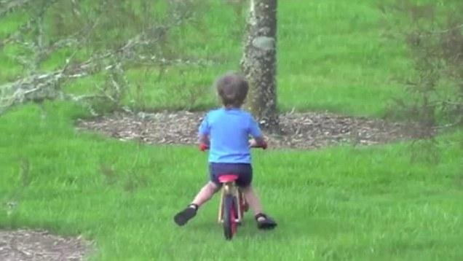
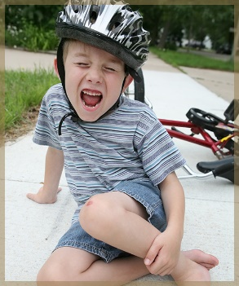
Tips on doing well in this course
Q: How many of you know how to ride a bicycle?
Q: How many of you fell down at least 10 times when learning?

Slide 32
Tips on doing well in this course
Q: How many of you know how to ride a bicycle?
Q: How many of you fell down at least 10 times when learning?
Q : What does this have to do with programming and python (what the heck is it, anyway)?

Slide 33
Tips on doing well in this course
Q: How many of you know how to ride a bicycle?
Q: How many of you fell down at least 10 times when learning?
Take home message 1 : Learning how to write a computer program is done by DOING … it is not enough for you to read about it, to look at videos on line on how to do, or by cramming the night before

Slide 34
Tips on doing well in this course
Learning how to program is like learning a new language
You learn by making mistakes
Then you try some more
Then you make more mistakes
Then you try some more
Then you make bigger mistakes and everything breaks

Slide 35
Tips on doing well in this course
Learning how to program is like learning a new language
You learn by making mistakes
Then you try some more
Then you make more mistakes
Then you try some more
Then you make bigger mistakes and everything breaks
Difficult question : What happens next?

Slide 36
Tips on doing well in this course
Learning how to program is like learning a new language
You learn by making mistakes
Then you try some more
Then you make more mistakes
Then you try some more
Then you make bigger mistakes and everything breaks
You get a coffee, come back, start over, ask for help, and try again … and then
Difficult question : What happens next?

Slide 37
Tips on doing well in this course
Learning how to program is like learning a new language
You learn by making mistakes
Then you try some more
Then you make more mistakes
Then you try some more
Then you make bigger mistakes and everything breaks
You get a coffee, come back, start over, ask for help, and try again … and then
You fix mistakes faster because you’ve seen them before

Slide 38
Tips on doing well in this course
Learning how to program is like learning a new language
You learn by making mistakes
Then you try some more
Then you make more mistakes
Then you try some more
Then you make bigger mistakes and everything breaks
You get a coffee, come back, start over, ask for help, and try again … and then
You fix mistakes faster because you’ve seen them before
Take home message 2 : Learning how to program and to think like a programmer takes time

Slide 39
Take home message 3 : Part of being proficient with writing code is learning to be comfortable with making mistakes … because NOBODY writes perfect code on the first attempt
Notes:
I’ll do live coding in this class, and even though I’ve been programming for over 20 years, I’ll still make mistakes!

Slide 40

ABCD Cards

Slide 41
Let’s program!

Slide 42
Syllabus

Slide 43
How do you get an ‘A’?
(OR REACH WHATEVER YOUR DEFINITION OF SUCCESS IS)

Slide 44
What is graded
20% Labs
10% Quizzes. Lowest 3 grade dropped.
50% Programming Assignments
10% Midterm exam
10% Final exam

Slide 45
Go to Lab
Virtual or in person
TAs will tell you if lab is in person or virtual each week
Learn from those next to you but type your own code
Attendance is recommended
If you need to change your lab section, talk to the TAs
Due 11:59 Friday after Lab
Lab directions posted to Canvas

Slide 46
Come to class / watch recordings
Quizzes are 10% of grade
Available from 10 minutes after lecture to 11:59 next night
Hint: Plan to take it after lecture, or before lecture. Put a reminder in your phone.
You can use a note sheet! So make a note sheet! (for real, on paper)
No makeup
3 Lowest grade dropped
If you’re struggling on these please come talk to me!

Slide 47
Start the 5 projects early
You can’t do them in one day. Start early.
Get instructions from Canvas
Follow rubric on assignment
Ask questions to Discord
Submit code to Canvas
Late? You get 3 ‘slip’ days. Claim by submitting to Canvas slip day assignment BEFORE deadline for each day
After that, 10% off per hour (better than ‘no late work accepted’....)
Grading feedback will be posted to Canvas

Slide 48
Prepare for exams
Midterm: October 26th in class
Final: Dec 9th 10:30-12:30
Multiple choice: practice using the quizzes!
Use Discord to form study groups
1 sheet of hand written notes allowed. Start it now!
Notes:
Show master calendar

Slide 49
Use Canvas
Announcements
The app does push notifications!
Grades
Use the ‘what if’ feature!
+ / - cutoffs determined at end of quarter based on overall class performance
Fraction of grades rounded 89.5% = 90% but 89.4% = 89%
Slides
Posted right after lecture
Links
To everything you need for the class

Slide 50

Read the suggested readings
Think like a computer scientist - learning with python: interactive edition 2.0
This book is available free online, linked to from Canvas
For extra coding practice: try CodingBat.com

Slide 51
Where to ask questions
See syllabus

Slide 52
Zoom help
Instructor office hours
TA office hours
CS Tutors
Free!
4-7pm M-F

Slide 53
Study with others, Code by yourself
Collaboration in learning = good!
But you need to do your own coding
Talk without sharing screenshots or copies of your work.
Hint: use a virtual whiteboard, or a shared document to sketch out pseudocode, or a pythontutor.com to show a syntax point
Rely on long term memory : ‘the ‘Star Trek Discoveries’ rule’
Automated tools will catch copied code, and according to university policy, you will fail the class
Cite your resources
Questions? Ask me in person or on Piazza
Notes:
Don’t get in the habit of making software by coping bits of code from everywhere! 1) you set yourself up for security issues 2) if it’s code for a job, it might be illegal:
The game designers of ‘Westworld’ game re-used code from Fallout Shelter, got busted, the game was shut down, and you can imagine what happened to those developer’s careers.
Google self driving cars sued Uber for $245 million over copied code
There were $500 million dollar lawsuits over coping code at UW Madison
Google and Oracle are in a $9 billion dollar lawsuit over using code without permission
What about open source software? Open source software is wonderful! but even that has a license, which requires you to give credit for borrowed code.
(also, if you borrow code instead of learning to do it yourself, you’re gonna have a bad time in the quizzes and exams for this class)
Nothing in this class isn’t already online. That’s not the point. The point is to get it into your head.

Slide 54


When things are not fine
REASONABLE ACCOMMODATIONS
STUDENT SERVICES
HTTPS://WWW.WWU.EDU/OVERVIEW-STUDENT-SERVICES
RESOURCES FOR SUCCESS LINK ON CANVAS
Notes:
If you have extraordinary challenges, come talk to me.
Also use student services on campus!

Slide 55





Misc Syllabus important notes
Workload: 2 hours per credit per week = 8 hours week
What counts as plagiarism
Extra credit: There will be some! But none in the last week. None after the final exam.
Feedback: canvas, in office hours, OR use the anonymous feedback form on Canvas!
Quizzes: don’t forget
Do not type while looking at any other code
Do not copy and paste
(yes all the solutions are out there. Now let’s get them into your head!)

Slide 56
Syllabus Questions?

Slide 57
Writing code …
Q: So what is this course all about … what is today’s most important take home message?

Slide 58
Writing code …
Q: So what is this course all about … what is today’s most important take home message?
A: This is the first of a sequence of classes that will teach you how to
Devise of a series of steps needed to solve a problem (pseudocode, the “thinking” portion of computer programming … the logic )
Use established syntax to write step-by-step instructions that the computer can understand (writing the code, the “doing” portion of computer programming)
Execute a program and fix errors (the debugging and maintenance portions of computer programming)
planning
coding
fixing
Notes:
Different students have different strengths and weaknesses … some are good at planning, some are good at syntax, some are good at debugging … a few are good at all 3 …

Slide 59
ABCD Cards - practice
Q1 : Which of the following statements is TRUE
Attending lecture and listening to Dr. Hardin talk about this-and-that awesome CS stuff is enough to guarantee an A in CSCI141 … and besides the lecture slides are self contained
Practice, Practice, Practice makes imperfect
1 + 1 = 3 (Earth, decimal system, no this is not a trick question)
In order to succeed in CSCI141, I should attend lecture, labs, form study groups, start homework assignments as soon as they are made available, practice, practice, and practice, and … yes, … , more practice

Slide 60
Next Class
Why Program
Computers : Hardware AND software
A program is …
Elements of a program
Debugging, errors, …
Programming Process
On the waitlist? Come talk to me after class!

